Slide 1
Module Identification for Biological Networks
Yijie Wang
Department of Electrical and Computer Engineering
Texas A&M University
Advisor: Xiaoning Qian

Slide 2
Biological Networks
Complex biological systems can be modeled as network systems.
Various types of molecular interactions are available due to advancement of profiling techniques.
Protein interaction networks
Gene co-expression networks

Slide 3
Module Identification
Biologically, a group of biological units performs specific functions.
Identify functional modules in biological networks
Function prediction
Organization of the biological systems

Slide 4
Challenges
Different from social networks, molecules work together with different interaction patterns; groups of molecules working together may have different sizes.
Degree heterogeneity.
Biological interactions in the biological networks generated by high-throughput experiments are very noisy.
Integration of different data sources.

Slide 5
Community Detection
For social networks, module identification is community detection.
Community
Intuitively, a good community in a (social) network G(V,E) should be a group of nodes C such that there are many more edges between the nodes in C than from the nodes in C to nodes in V − C.

Slide 6
Modularity
Given G(V,E) and its adjacency matrix A.
For a node set C, the modularity of C is defined as the subtraction between actual and expected number of edges in C.
Formally,
δ_{ic} denotes whether node i belongs to C and P_{ij} is
the expected number of edges between nodes i
and j.

Slide 7
Community Detection by Modularity
For identifying k non-overlapping communities, we can maximize the corresponding modularity.
Underlying assumption: nodes in the same module are connected as dense as possible but rarely connect with the rest of the network.
Image graph

Slide 8
From Modularity to Block Modeling
Biological Observation
Functional modules in Protein Interaction Network (PIN).
receptors in signal transduction cascades
extra-cellular ligands
cytoplasmic proteins

Slide 9
From Modularity to Block Modeling
Modularity: Subtraction between actual and expected number of edges within modules.
Block modeling: Subtraction between actual and expected number of edges within and between modules.
Interaction patterns in the same module are similar!
Image graph

Slide 10
From Modularity to Block Modeling
Modularity
Block modeling
B (image graph) is an unknown binary matrix describing the connectivity among modules.
Modularity is a special case of Block modeling.

Slide 11
From Modularity to Block Modeling
Modularity
Block modeling
Spectral clustering: eigen-system of A-P^{[1]}
Simulated annealing^{[4]}
SGPG^{[5]}
Greedy method^{[2]}
Mixture integer programming^{[3]}
[1] M. E. J. Newman. Finding community structure in networks using the eigenvectors of matrices. Phys. Rev. E 74:036104 (2006).
[2] P. J. Mucha, et al. Community structure in time-dependent, multiscale, and multiplex networks. Science 328:876-878 (2010).
[3] D. Aloise and et al. Column generation algorithms for exact modularity maximization in networks. Phys Rev E, 82:046112 (2010 ).
[4] J Reichardt. Structure in Complex Networks. Springer, 2009
[5] Y. Wang and X. Qian. A novel subgradient-based optimization algorithm for blockmodel functional module identification. BMC Bioinformatics, 14(Suppl 2):S23 (2013).

Slide 12
Block Modeling
Therefore, δ and B are decoupled!!!
[1] Reichardt J: Structure in Networks Springer-Verlag Berlin Heidelberg; 2008

Slide 13
Sub-gradient Frank-Wolfe with Path Generation
Use convex optimization method to fast generate lots of local optima.
Extension of Frank-Wolfe method: sub-gradient
Achieve better solutions by applying path generation strategy.

Slide 14
Matrix Formulation

Slide 15
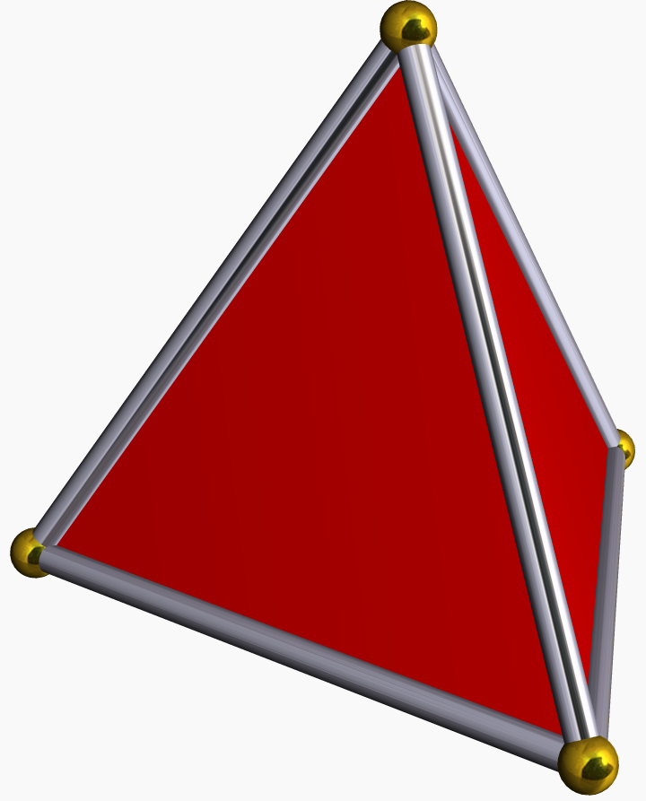
Why Frank-Wolfe Method
Frank-Wolfe Method
Find the derivative of the objective function
Solve linear programming problem (sub-problem) to get the descent direction
Search step size
The constraint set is a convex hull
Each row of S is a simplex
Solution of the sub-problem on the extreme points
is non-smooth, use instead of

Slide 16
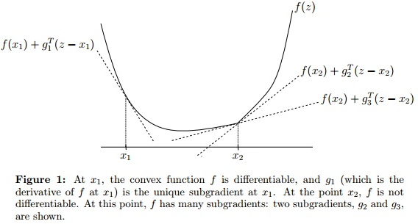
Subgradient
Boyd, Stephen P.; Vandenberghe, Lieven (2004) . Convex Optimization. Cambridge University Press.

Slide 17
Subgradient
My Proposition:
where and α is a number between [-1, 1].
[1] Wang, Y. and Qian, X. (2013). A novel subgradient-based optimization algorithm for block model functional module identification. In Asia Pacific Bioinformatics Conference 2013.

Slide 18
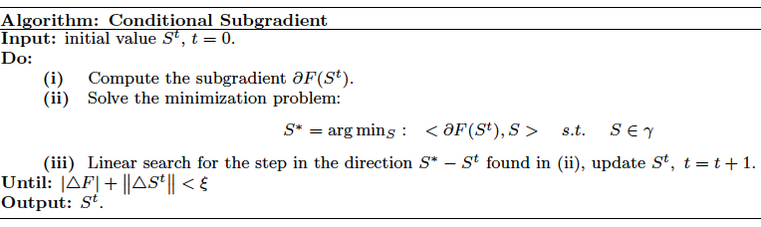
Sub-gradient Frank-Wolfe Method
Worst case time complexity O(kN²).
Guarantee to converge to stationary points.

Slide 19
Path Generation (PG)
In order to make use of the “good stuff” shared by the local optima and further explore feasible solution space constrained by local optima for better solutions, we propose a novel heuristic method to search for better solutions.
S_{A}
S_{B}
F. Glover, M. Laguna, R. Marti. Fundamentals of scatter search and path relinking. Control and Cybernetics, 29 (3): 653–684 (2000)

Slide 20
Path Generation
1
5
3
5
1
3
2
6
4
7
6
2
4
7
3
1
6
4
4
1
2
2
7
5
1
3
5
4
6
2
7
where is overlap between S_{A} and S_{B}.
3
1
6
4
2
5
7

Slide 21
Path Generation
3
5
1
6
1
3
4
6
2
5
7
2
4
7
5
3
4
5
1
3
6
2
4
7
3
1
6
4
2
5
7

Slide 22
Path Generation
3
5
1
6
1
3
4
6
2
5
7
2
4
7
6
7
5
3
1
6
4
2
5
7
3
1
6
4
2
5
7

Slide 23
Path Generation
3
3
3
1
6
1
6
1
6
4
4
4
2
5
7
2
5
7
2
5
7
3
1
6
Choose the best.
4
2
7
5

Slide 24
SGPG vs. SA
Protein-protein interaction (PPI) networks
Sce PPI network
DIP Database
4,990 nodes with 21,911 edges
Hsa PPI network
Human Protein Reference Database
9,270 nodes with 36,917 edges
Performance comparison
Mathematical and biological performance
Mathematical: objective function value
Biological: Gene Ontology analysis
Computational time

Slide 25
SGPG vs. SA
Mathematical and Time Comparison
Results of SA can be viewed as the optimal solution.

Slide 26
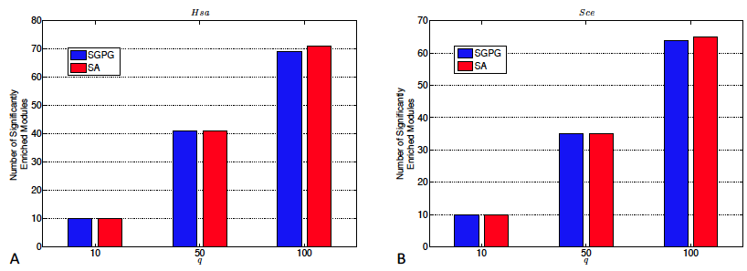
SGPG vs. SA
Biological performance
We consider a module biologically enriched when it has significantly enriched GO terms below 1% after Bonferroni correction.

Slide 27
Conclusion
SGPG has the competitive performance with simulated annealing, but works more fast.

Slide 28
Resolution Problem
Modularity optimization^{[1]}
Modularity optimization may miss modules with small sizes^{[2].}
Modularity is a special case of block modeling, which also suffers the resolution problem.
[1] Newman M. (2006). Modularity and community structure in networks, PNAS, 103(23): 8577–8582.
[2] Santo F. and Marc B.(2007). Resolution limit in community detection, PNAS, 104(1): 36-41.

Slide 29
Normalized Cut
Formulation
Do not have the resolution problem.
Equivalent to the random walk on networks.

Slide 30
Random Walk on Networks
If a random walker starts at a node and travel randomly to connected nodes, then he is more likely to be trapped in a small sub-network.
Low conductance of the Markov Chain

Slide 31
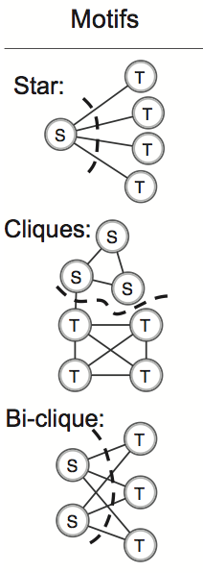

One-hop vs. Two-hop
Random Walk
Two-hop Random Walk

Slide 32
One-hop vs. Two-hop
Random Walk (LCP):
Two-hop Random Walk (LCP²):

Slide 33
One-hop vs. Two-hop

Slide 34
Two-hop Random Walk
Proof:

Slide 35
Spectral Method

Slide 36
Greedy Method
Overlapping Modules
Seed expansion algorithm
Consider each node as a seed and grow the seed based on
Merge highly overlapped modules

Slide 37
Greedy Method

Slide 38
Experiment
Protein Complex Prediction
Sparse Module Identification

Slide 39
State-of-the-art Methods (non-overlapping)
LCP
RMCL
MCL
PG
GS
Xing, E. and Jordan, M. (2003). On semi-definite relaxation for normalized k-cut and connections to spectral clustering. Technical report, UC. Berkeley.
Satuluri, V., Parthasarathy, S., and Ucar, D. (2010). Markov clustering of protein interaction networks. In ACM BCB 2010.
van Dongen, S. (2000). A cluster algorithm for graphs. Technical Report INS-R0010.
Royer, L., Reimann, M., et al. (2008). Unraveling protein networks with power graph
analysis. PLoS Comput Biol, 4(7), e1000108.
Navlakha, S., Rastogi, R., and Shrivastava, N. (2008). Graph summarization with bounded error. Processing of the 33rd International Conference on Management of Data, pages 419–432.

Slide 40
State-of-the-art Methods (overlapping)
ClusterOne
LinkCommunity
Nepusz, T., Yu, H., and Paccanaro, A. (2012a). Detecting overlapping protein complexes in protein-protein interaction networks. Nature Methods, 9(471-472).
Ahn, Y. Y., Bagrow, J. P., and Lehmann, S. (2010). Link communities reveal multiscale complexity in networks. Nature, 466, 761–764.

Slide 41
Complex Prediction

Slide 42
Sparse Module Identification
The pro-survival proteins directly
or indirectly prevent the release of
cytochrome c from mitochondria^{[1]}.
[1] Yang, J., Liu, X., and et al (1997). Prevention of apoptosis by bcl-2: Release of cytochrome c from mitochondria blocked. Science, 275(1129-1132).

Slide 43
Sparse Module Identification
FGF/FGFR signaling has been associated with a diverse and broad range of biological functions, including cell growth, cell differentiation, and the promotion of angiogenesis.

Slide 44
Conclusion
We propose a novel formulation to achieve functional module identification based on protein interaction patterns in PPI networks.
Spectral method and greedy method are developed to yield non-overlapping and overlapping results.
Our algorithms overcome the limitation of traditional module identification algorithms, which only focus on identifying dense modules.
Do not have the resolution problem.

Slide 45
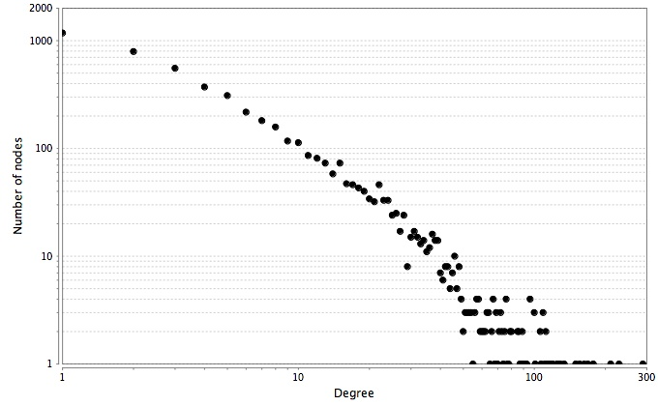
Overcoming the degree heterogeneity
Power law distribution

Slide 46
Degree heterogeneity

Slide 47
Overcoming the degree heterogeneity
Most of algorithms designed for biological networks do not consider the degree heterogeneity.
Algorithms designed for conquering degree heterogeneity have not been used on biological networks.

Slide 48
Spectral Clustering of Graphs with General Degrees^{[1]}
Using top eigenvectors of the transition matrix of the degree-corrected random walk^{[1]}.
“Even if the graph has very many low degree nodes, which cannot be reliably clustered because we simply do not have enough adjacent edges available, our algorithm can still use these nodes in the degree-corrected Laplacian to compute a subspace for clustering the high degree nodes reliably.”^{[1]}
[1] K. Chaudhuri, F. Chung, and A. Tsiatas. Spectral clustering of graphs with general degrees
in the extended planted partition model. Journal of Machine Learning Research, 2012:1–23 (2012).

Slide 49
Laplacian
Laplacian:
Random Walk Laplacian:
Degree-corrected
Random Walk Laplacian:

Slide 50
Spectral Clustering of Graphs with General Degrees
Eigenvectors of
Same eigenvectors as

Slide 51
Spectral Clustering of Graphs with General Degrees
Consider X as the module assignment matrix.
Transformation
Find modules with both properties!!!
conductance
density
separability
“cohesiveness”

Slide 52
FLCD
Two-step local algorithm:
1. Finding low-conductance set H_{v}* near node v.
2. Carving the cohesive part C out of H_{v}*.

Slide 53
Find low-conductance set H_{v}* near node v
Personalized PageRank vector^{[1]}
v is the starting node, α is the teleport constant,
e_{v} is the indicator vector and W is the transition
matrix of the lazy random walk.
Using p(α,v) to rank the nodes in the network, and taking the top k nodes as potential low-conductance set H_{v}.
Approximation of p(α,v) in O(|H_{v}|) with guarantee^{[1]}.
[1] R. Andersen, F. Chung, and K. Lang. Local graph partitioning using pagerank vectors. In 2006 47th Annual IEEE Symposium on Foundations of Computer Science (FOCS’06), 475–486 (2006)

Slide 54
Find Low-conductance Set H_{v}* Near nNode v
Searching for H_{v}* in H_{v} using MIP.

Slide 55
Carve the Cohesive Part C out of H_{v}*
Find the densest sub-network C in H_{v}* by solving the following MIP problem.
Node set C is considered as a good module identified by FLCD.

Slide 56
Illustration
PageRank-Nibble
MIP refines the result
Search for the densest sub-network

Slide 57
Protein complex prediction

Slide 58
Protein complex prediction

Slide 59
Borrow strengths across networks: ClusterM
Extension of FLCD to multiple networks.
Use homological information to reduce the influence of false negative edges.

Slide 60
Motivation

Slide 61
ClusterM procedure
Three-step procedure.
Network alignment.
Searching low-conductance sets on each network.
Finding aligned conserved modules across networks with cohesive homological node correspondence.

Slide 62
ClusterM
Network alignment.
Search for low-conductance set on each network.

Slide 63
Key step
Objective function for the final step
Density function for each sub-network. Require modules in each network to be topologically cohesive.
Density function for homological information. Require many-to-many correspondence between nodes across different networks.

Slide 64
Competing algorithms
OC: OrthoClust
NB: NetworkBlast
MaWISh
NB-M: NetworkBlast-M
CONE: ClusterONE
LinkC: LinkCommunity

Slide 65
Protein complex prediction
λ
Find conserved modules in yeast and human PINs obtained from DIP.

Slide 66
Protein function prediction

Slide 67
Conserved proteasome core complex
Yeast: p-value 4.26E-32
Fly: p-value 4.40E-20
Worm: p-value 3.63E-15
Human: p-value 1.06E-39

Slide 68
Conclusions
Different from social networks, molecules work together with different interaction patterns; groups of molecules working together may have different sizes.
Block modeling
Interaction pattern
SGPG, SLCP2 and GLCP2

Slide 69
Conclusions
Degree heterogeneity.
FLCD
Modules (well separated and cohesive)

Slide 70
Conclusions
Biological interactions in the biological networks generated by high-throughput experiments are very noisy.
Integration of different data sources.
ClusterM
Borrow strength across networks

Slide 71
Future Work
Overcoming the degree heterogeneity for block modeling
Extend ClusterM to consider interaction patterns
Thank you!

Slide 72
Protein Interaction Networks

Slide 73
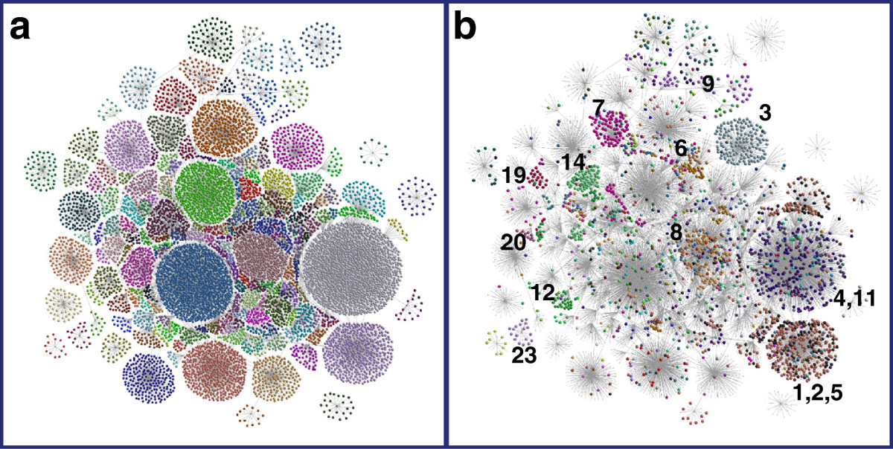
Gene Co-expression Networks
Tamasin N Doig, et al. Coexpression analysis of large cancer datasets provides insight into the cellular phenotypes of the tumour microenvironment. BMC Genomics, 14:469, 2013.

Slide 74
Modularity
Matrix P
If C=V, Q_{c} = 0
P is symmetric
Degree distribution is the same as A.
Therefore,

Slide 75
GO Consistency

